Slide 1

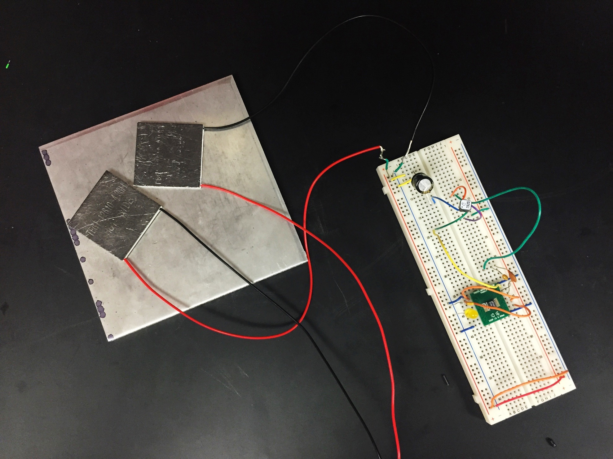
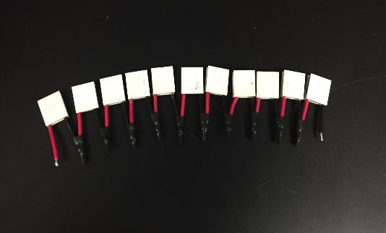
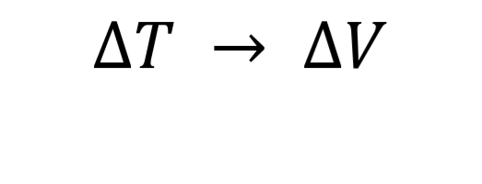
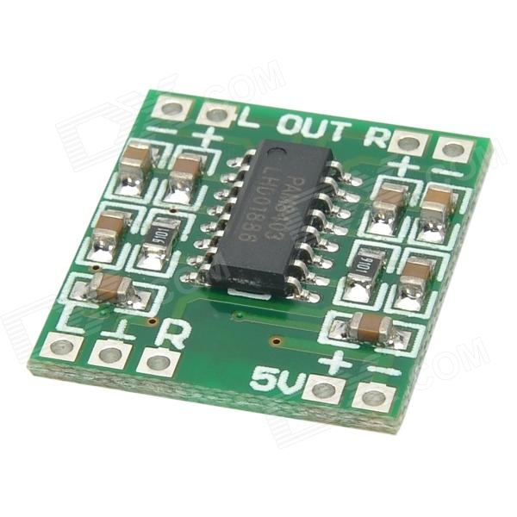
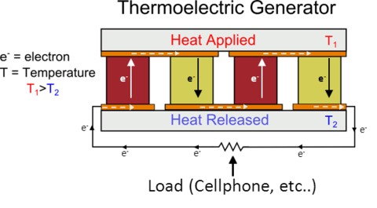
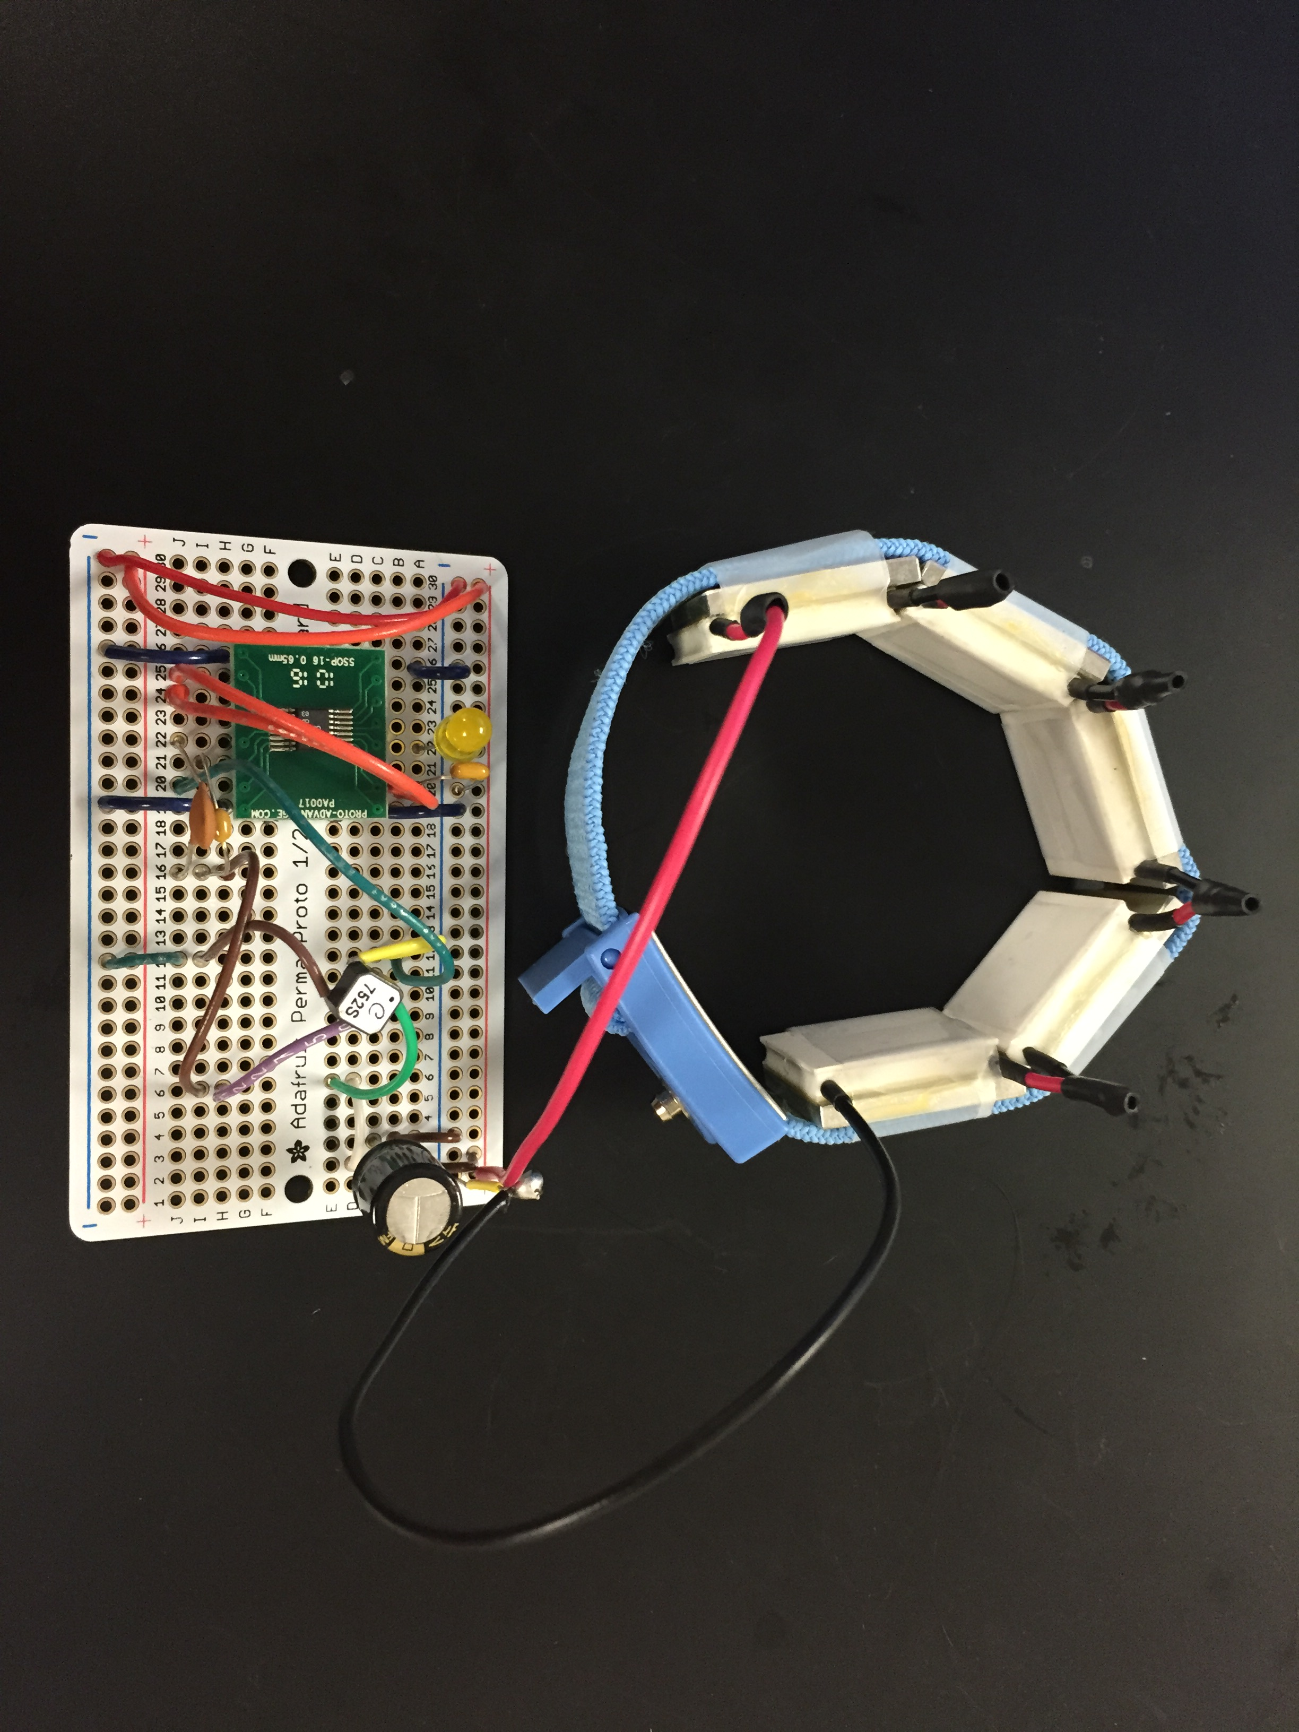
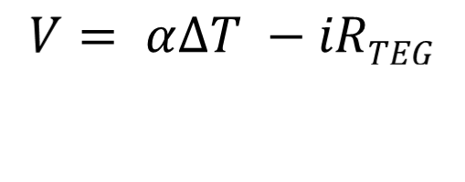
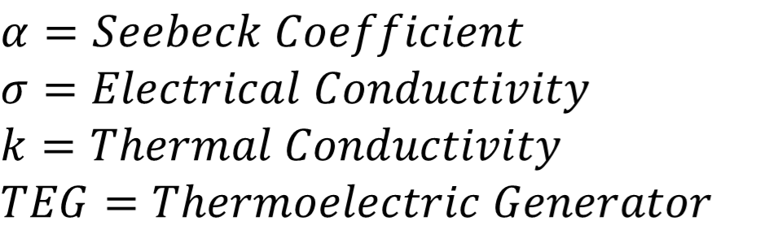
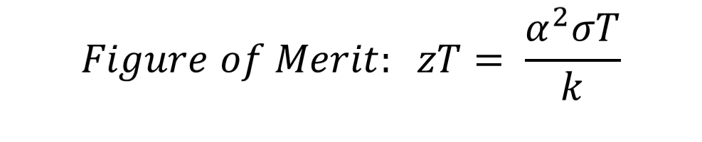
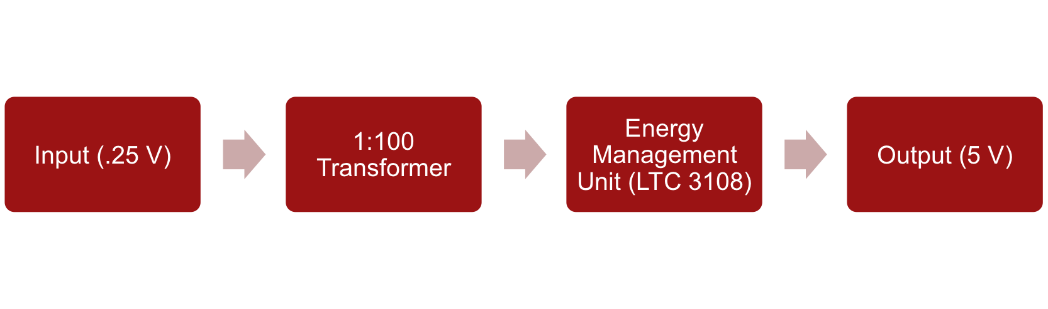
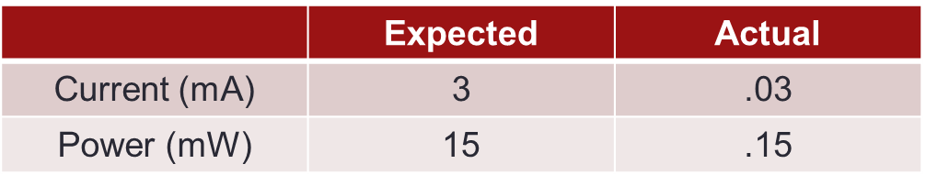
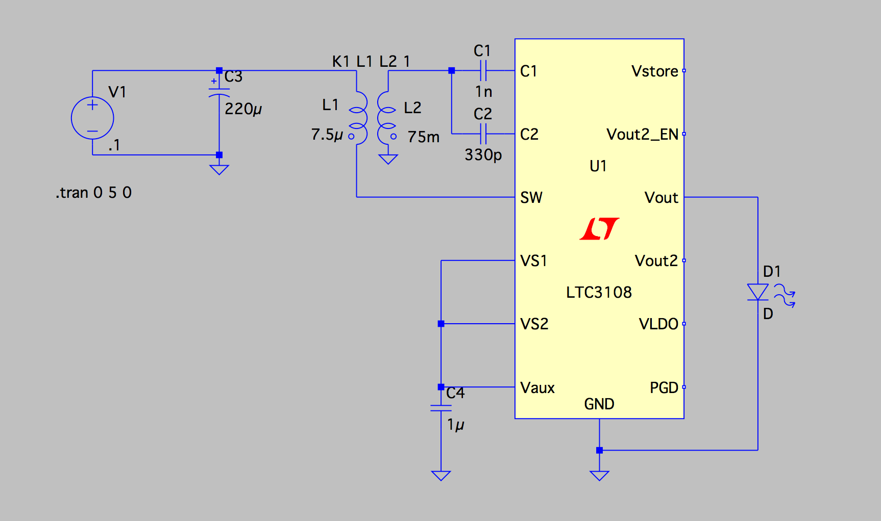
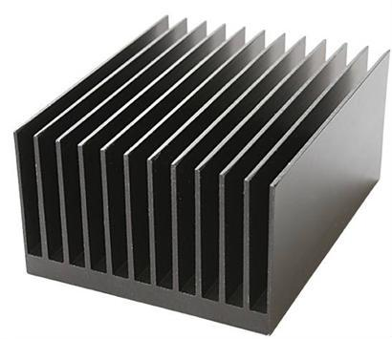
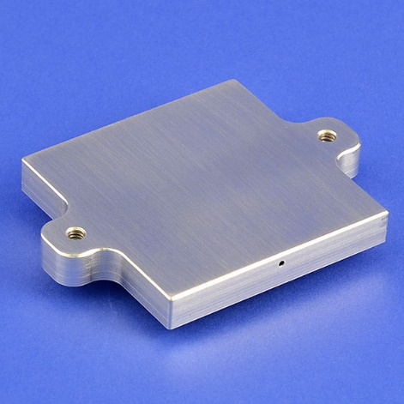
A Wearable Bracelet for Thermoelectric Energy Harvesting
Priyanka Rao
Advised by Feifei Lian, Rachel Luo, and Prof. Eric Pop
Motivation
Prototypes
Future Work
How can human body heat be used to power small electronics and devices, such as LEDs?
Boosting power
Adding storage capacitor for extra voltage
Increasing efficiency
Using different materials and heat sinks
Making PCB
Cost reduction and packaging
Background
Seebeck Effect:
Figure 1. Breadboard prototype with large TEGs
Figure 2. TEG Bracelet formed from 1 cm x 1 cm TEGs
Figure | TEG Input Voltage (mV)
1 | 250
2 | 10 - 20
3 | 175
Acknowledgements & Contact Information
Special thanks to Prof. Eric Pop, Feifei Lian, Rachel Luo, and PopLab members for their guidance.
Figure 3. Current bracelet with 2.3 cm x 2.3 cm TEGs and perf board
Email: prao96@stanford.edu
How it Works
Challenges
References
Low output power due to 1:100 transformer
Minimizing bracelet size while maintaining sufficient input voltage (min 20 mV)
Maximizing heat differential
Adjusting to body temperature fluctuations
[1] Gambier, P., S. R. Anton. "Piezoelectric, Solar and
Thermal Energy Harvesting for Hybrid Low-power
Generator Systems with Thin-film Batteries."
Measurement Science and Technology 23.1 (2011): IOP
Science. IOP Publishing, 25 Nov. 2011.
[2] Salerno, Dave. "Ultralow-voltage Energy Harvester
Powers Wireless Sensors from Waste Heat." EETimes.
UBM Canon Electronics Engineering Communities, 13
Jan. 2011.
[3] "Thermoelectric Engineering." Thermoelectrics.
Northwestern Materials Science and Engineering, Web.
[4] Wensi Wang, Victor Cionca, Ningning Wang.
“Thermoelectric Energy Harvesting for Building Energy
Management Wireless Sensor Networks,” International
Journal of Distributed Sensor Networks, vol. 2013,
Article ID 232438, 14 pages, 2013. doi:
10.1155/2013/232438

